Slide 1
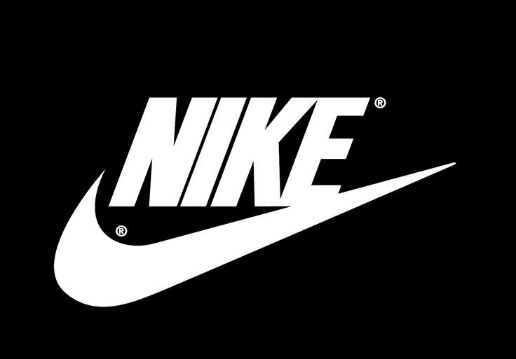
Revenue Prediction of NIKE Inc. using RapidMiner
Amit Lamsal
CSIS 5420: Machine Learning for Business
Prof. Ahmad Rabiu
Student Id: 4262165
03/11/2025

Slide 2

Background
Financial Analysis is the process of assessing the financial health of a company using its key metrics.
Nike is the global market leader in sportswear and apparel and are also renowned for its innovation, branding, sustainability.
Data Exploration: (Dataset Obtained from official company (nike.com) and Government (sec.gov) websites.
Labels | Items and Sources
Financial attributes | Revenue, Assets, Liabilities, LTD, CAPEX, Cash on Hand
Macro Variables | GDP Growth rates, Unemployment rates, Inflation
Data Sources | Nike.com, Sec.gov.np, fred.stlouisfed.org, worldbank

Slide 3
Project Goals
The major objective it to predict the revenue of NIKE company for the coming quarters or years in consideration with some of its financial attributes and macro economic variables.
Macro-economic variable: GDP Growth rate, Unemployment rate, and Inflation rate
Competitors Information was also taken (ADIDAS).

Slide 4
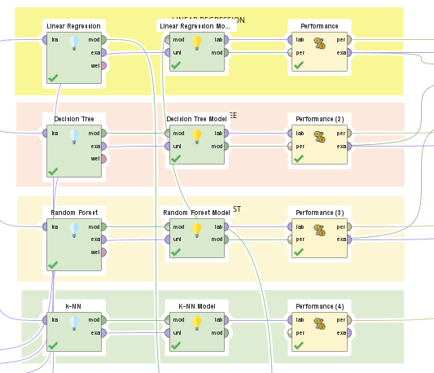
Analysis: Methods used in project
Linear Regression
Decision Tree
Random Forest
K-NN

Slide 5
Analysis: Methods used in project
Performance Vectors:
Squared Correlation (R^2) = Closer to 1 is better
Root Mean Square Error (RMSE) = Lower is better
Absolute Error = Lower is better
Linear Regression
R^2 = 0.907
A Error= 684.3
Decision Tree
R^2 = 0.014
Random Forest
R^2 = 0.877
K-NN
RMSE=993.959
RMSE=3575.71
A Error= 1998.3
RMSE=1126.3
A Error= 846.5
R^2 = 0.94
RMSE=710.34
A Error= 593.8

Slide 6

Final Method Selection:
Linear Regression was selected despite K-NN being better in all performance vectors. This is because:
K-NN is not suitable for predicting time series with a global trend.
Computational Cost: The model's efficiency decreases with large datasets.
The accuracy of predictions depends on the availability and quality of historical data.
Hence, the second best (Linear Regression) is selected for the model.

Slide 7
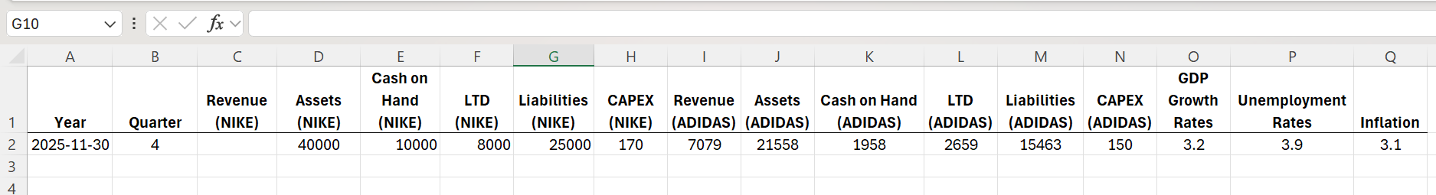
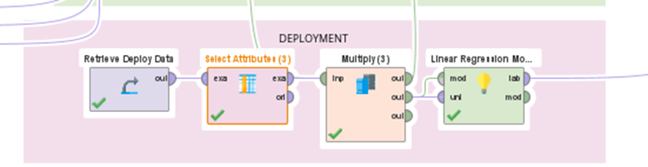
Model Deployment
Created a new dataset (deploy dataset ) for the model deployment by changing the data values.
Used linear regression model to predict the revenue.

Slide 8
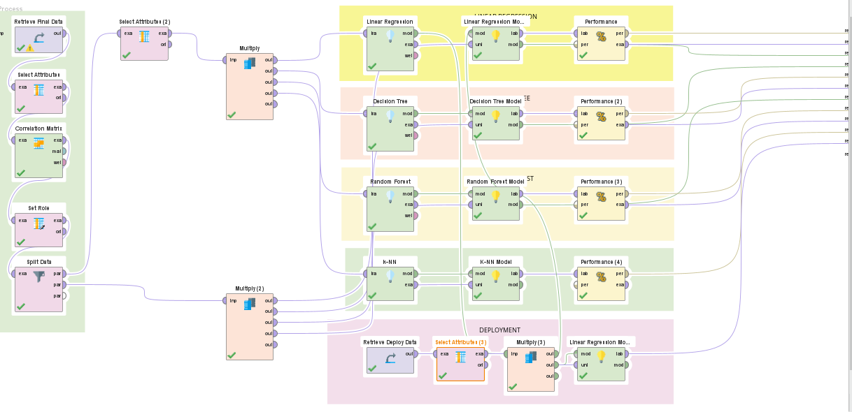
RAPIDMINER DESIGN

Slide 9
Conclusion
Objective: Predict Nike's future revenue using machine learning in RapidMiner.
Data Collection: Gathered financial data from sources like SEC filings, Federal Reserve data, and Nike’s investor relations.
Dataset Details: Included financial indicators (e.g., total assets, liabilities, revenue) from 2009 to 2024 in quarterly format.
Data Splitting: Divided into 60% training and 40% testing data.
Model Selection: Tested four models — Linear Regression, Decision Tree, Random Forest, and K-NN.
Final Model Choice: Linear Regression selected for its superior performance
Deployment

Slide 10

Questions ?

